Slide 1
Your Trip Recorder
State Fair Project

Slide 2
Contents
Introduction
Possible Methods
Use Case
Software
Data Flow Diagram
Project Architecture
Details
Benefits
Updates and Upgrades
Licensing

Slide 3
Introduction
Most of the people in the United States use cars as the major means of transportation. This fact lead me think if there could be a way of capturing the data of where the people travel.
This intuition became my project – My Trip Recorder

Slide 4
Possible Methods of achieving this goal Part 1
OpenXC Vehicle Interface
This is a platform that supports mobile applications to gather data from the car’s OBD port.
What
Very customized to work with your car.
Ignition status, RPM, speed, break status, fuel level etc.
Examples
Track a vehicle and its status, monitor the vehicle’s route, and perform automated functions.
Uses

Slide 5
Possible Methods of achieving this goal Part 2
Mobile App Interaction
An android app that requires user interaction in order to capture data.
What
Examples
User Location, time when user interacts with the phone.
Track the user location only when needed. Track only the location which reduces the unnecessary information.
Uses

Slide 6
Use Case
Summary
A lost possession can be found by finding where a person went on that particular day.
Necessity
Using the latest technology to gather user location on app interaction and to display the data to the user using a webpage.
View where they went.
Forgot whether you attended a particular class for paying the monthly fees.

Slide 7
Software Used
Online application with several tools to make the perfect apps. JSON: Used to store data in a tree format.
Firebase, JSON
A widely used programming language used to make Android Marshmallow apps using SDK version 2.2.3 (latest)
Latest Technology
Java and Android
JS, Bootstrap, HTML
Rising Bootstrap template for HTML and the most popular language JavaScript are used for the webpage created.

Slide 8
Data Flow Diagram
Capture data from Car using Android Application.
Push the data to Firebase
Read data from database using JavaScript
Show results to user in a responsive website.
Implement Search Function for easier user interface.

Slide 9



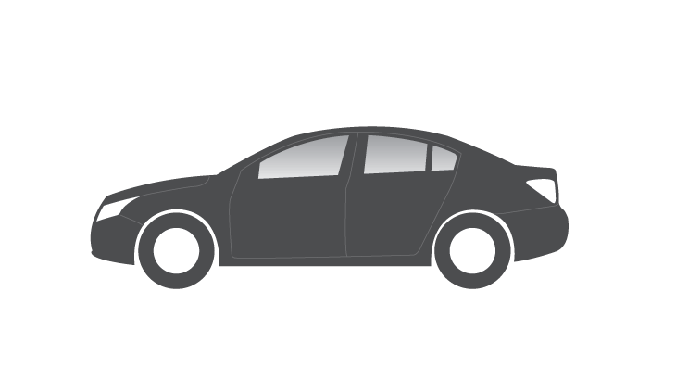
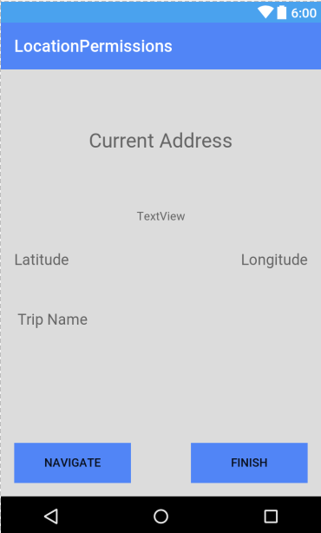

Project Architecture

Slide 10
DETAILS OF THIS PROJECT

Slide 11

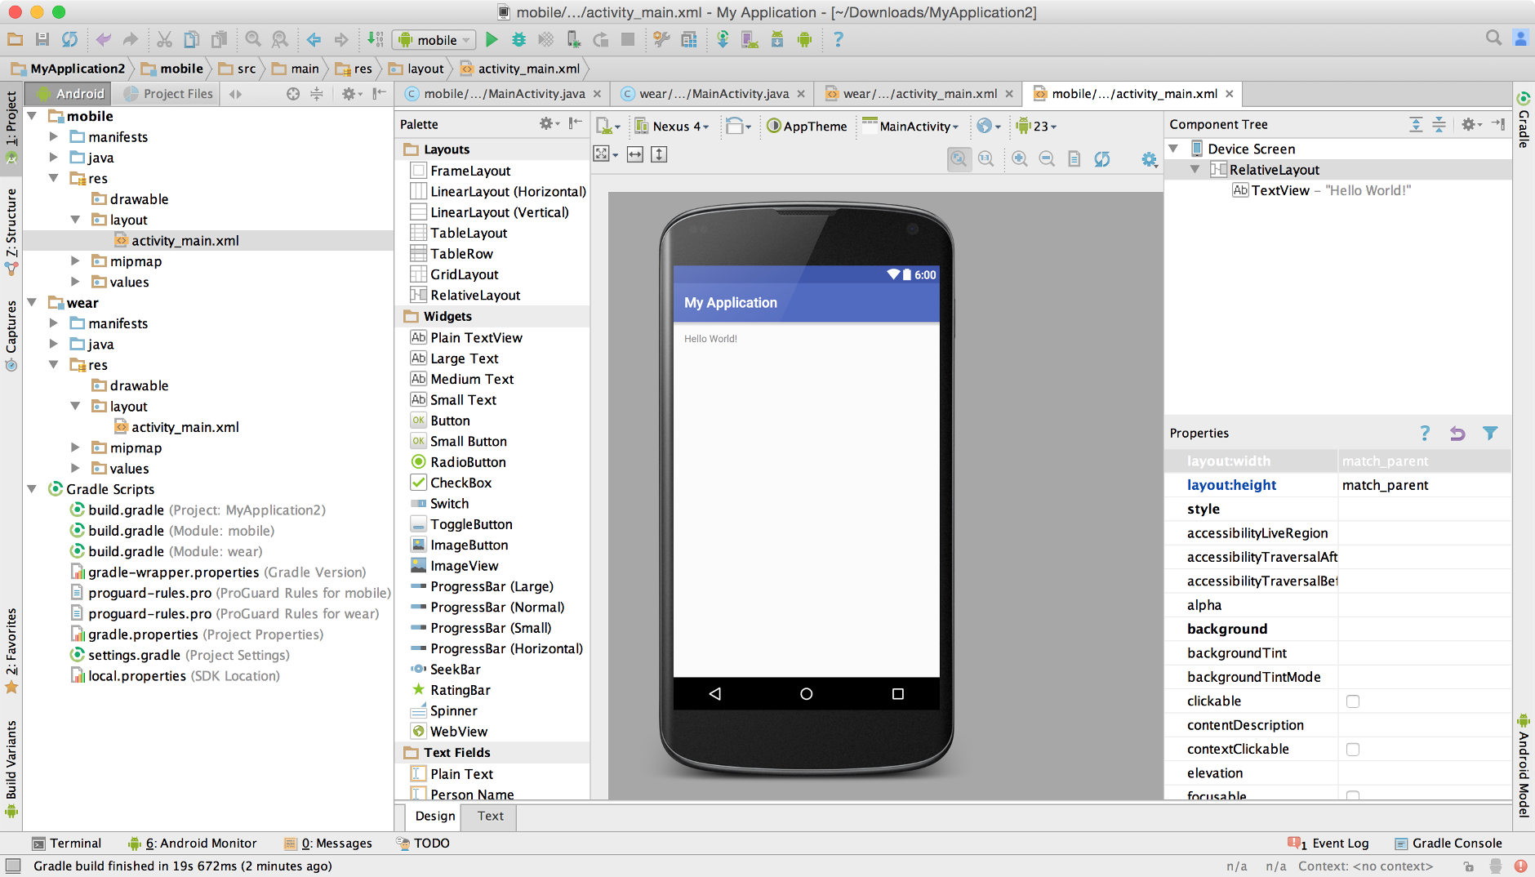
Android Studio
Description
Software used to create Android Apps. Used to get user location.
Description
Sneak peak

Slide 12
How do I get the User Location?
Setup Location Permissions.
Setup GPS Provider for getting GPS Coordinates.
Convert the coordinates to location address.
Show the data to the user.

Slide 13
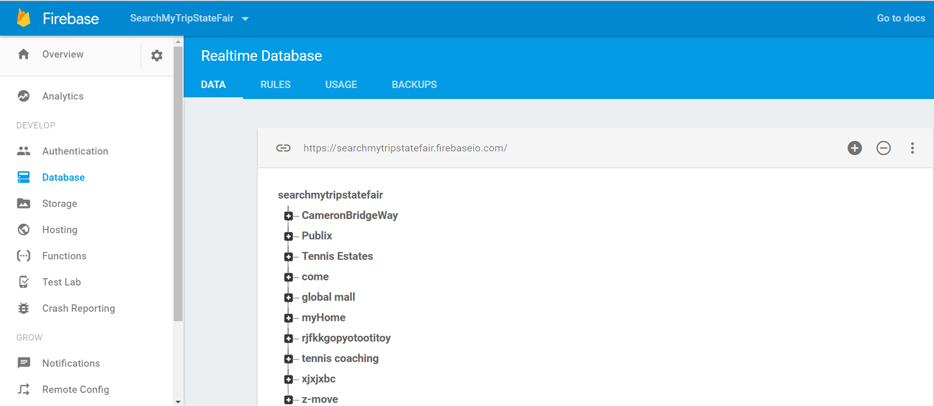
Firebase
Description
A mobile and web based online platform by Google with inbuilt tools such as hosting and database to make high quality apps for all platforms.
Sneak Peak

Slide 14
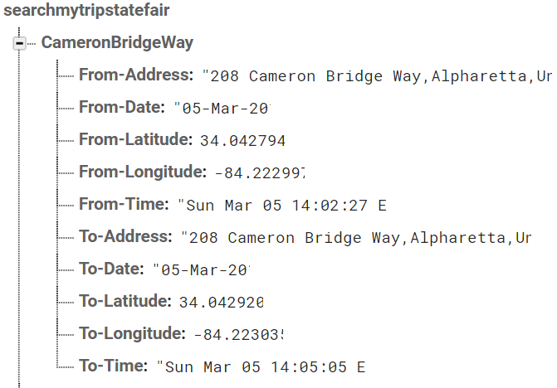
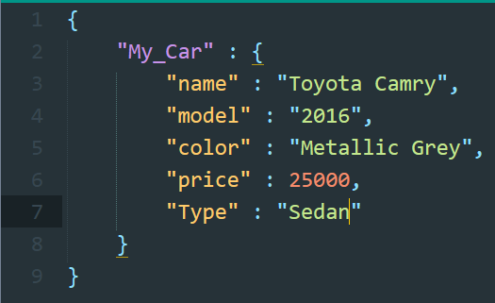
Firebase Database
What is it?
Tree Representation
Online Database that uses JavaScript Object Notation to store data in a tree like format.
For Example

Slide 15
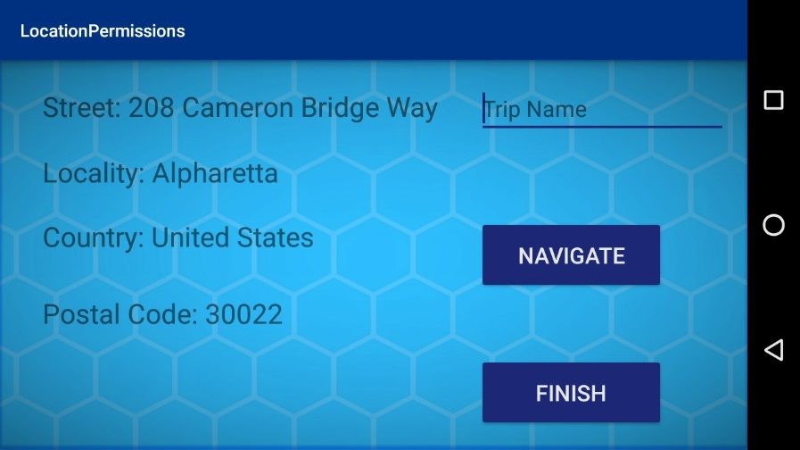
Android App Interface
The Current address text field which will display the current address when the app is active
The input text field where the user will enter the Trip Name.
Buttons that will insert the FROM data and the TO data.

Slide 16
Important Android Code Snippets

Slide 17
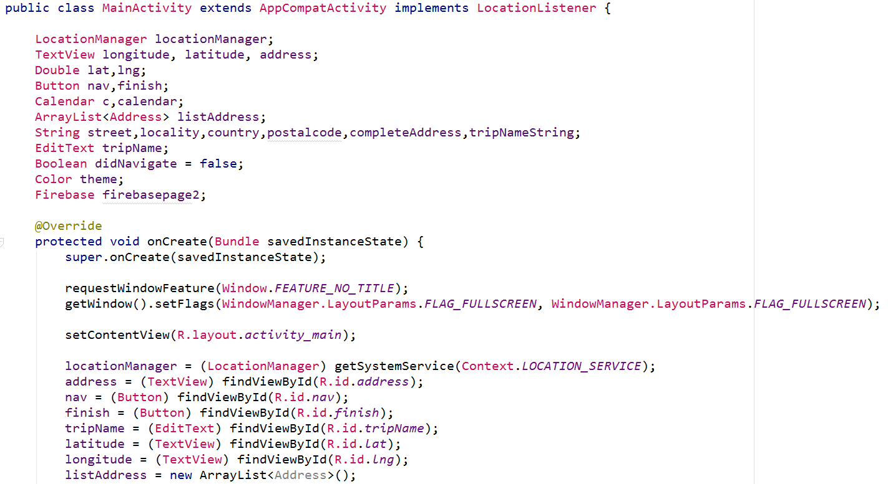
Android Code Part 1
Creating global variables to use within the program.
Initializing the global variables when the app is created.

Slide 18
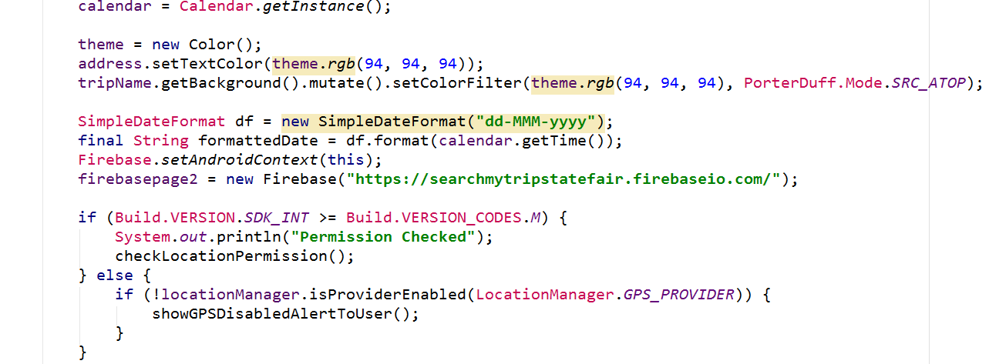
Android Code Part 2
Modifying the elements to look good aesthetically.
Setting up the location permissions for the user. This will very important to gather location data.
Setting up Date, Time and the Firebase variable to access it later on.

Slide 19
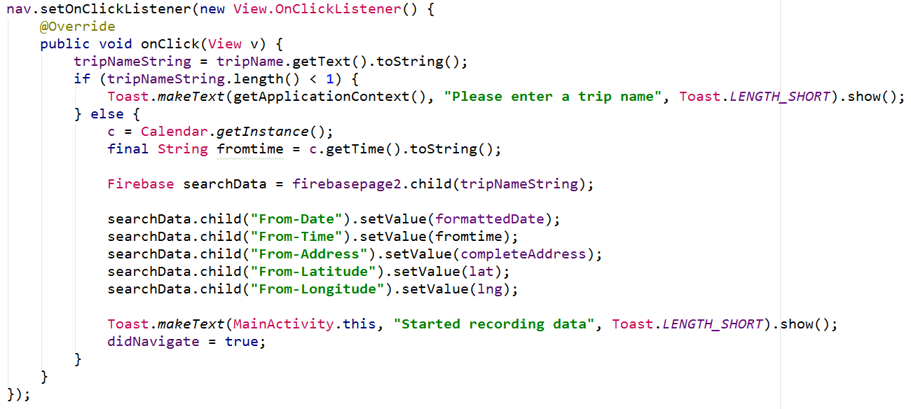
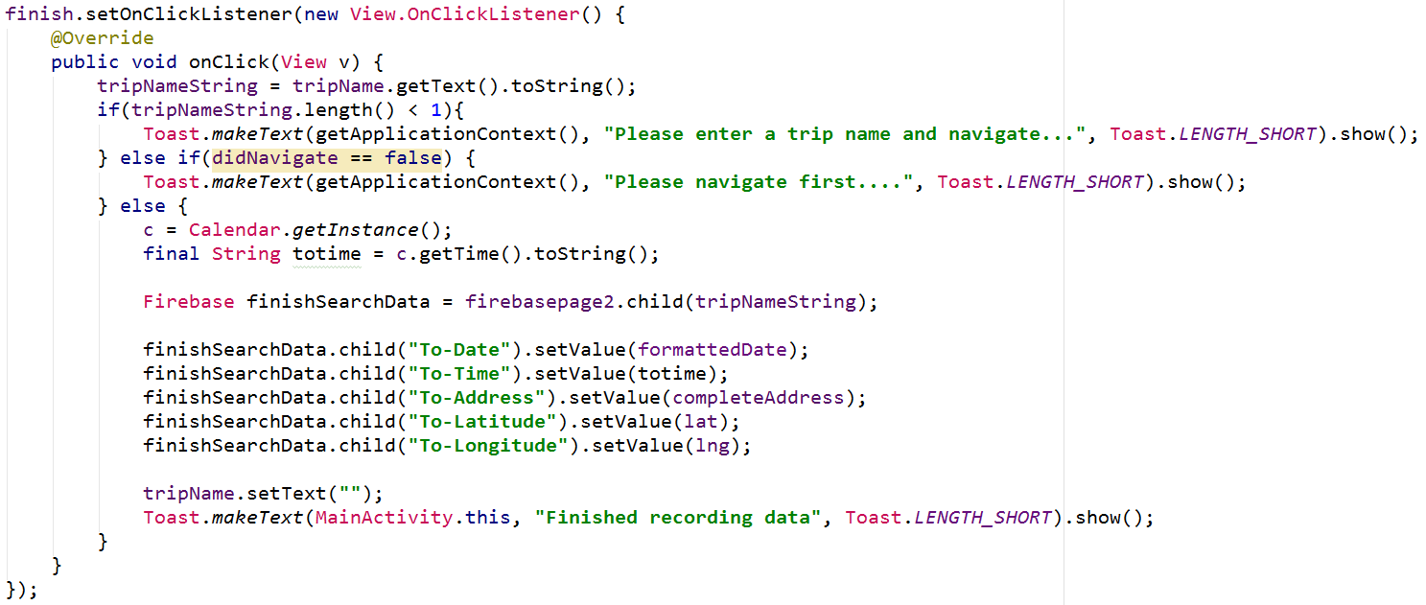
Android Code Part 3
The listener that will listen to the button click.
This will occur when the user clicks on the navigate button.
This will add the data to the firebase database.
The listener that will listen to the button click.
This will occur when the user clicks on the finish button.
This will add the data to the firebase database.

Slide 20
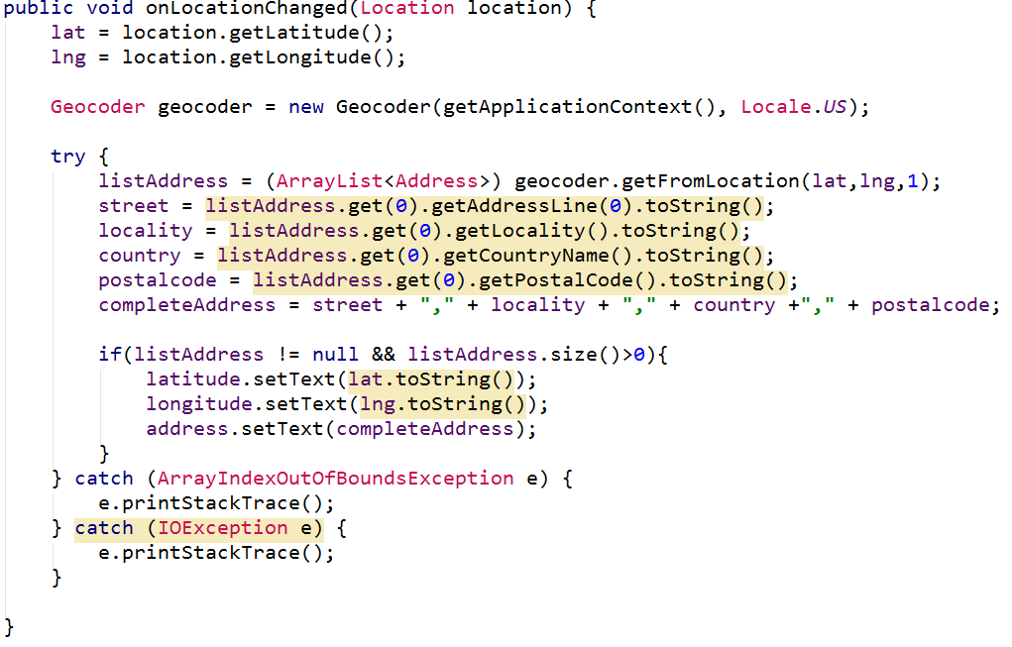
Android Code Part 4
When the location changes, longitudinal and latitudinal coordinates are captured.
Derives location address using the coordinates captured in the previous lines of code.

Slide 21
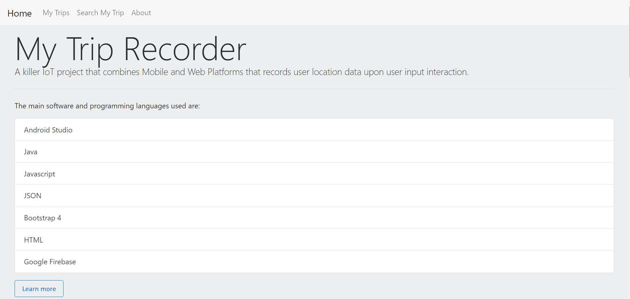
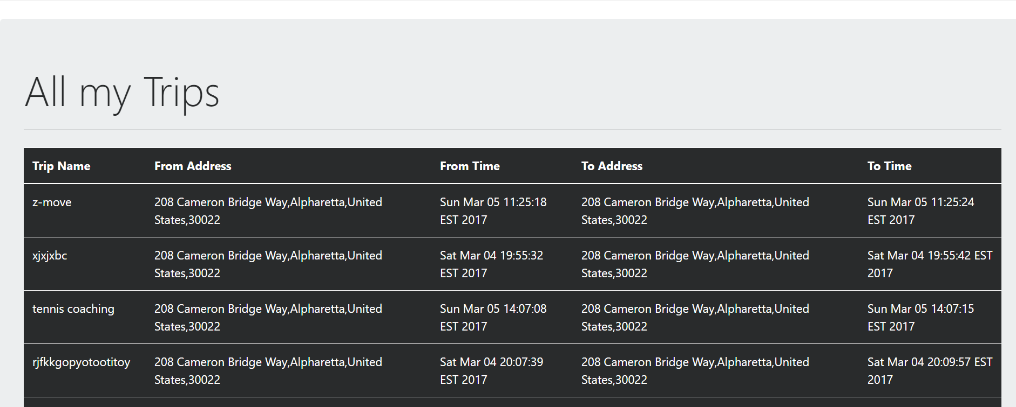
The Website
The Home Page
A snippet of the Trip Data Page

Slide 22
How to get the Data from Firebase?
Setup project using Google Firebase by pasting the required code.
Initialize firebase using JavaScript.
Get value using the on value attribute function.
Display the data to the user.

Slide 23
Important Webpage Code

Slide 24
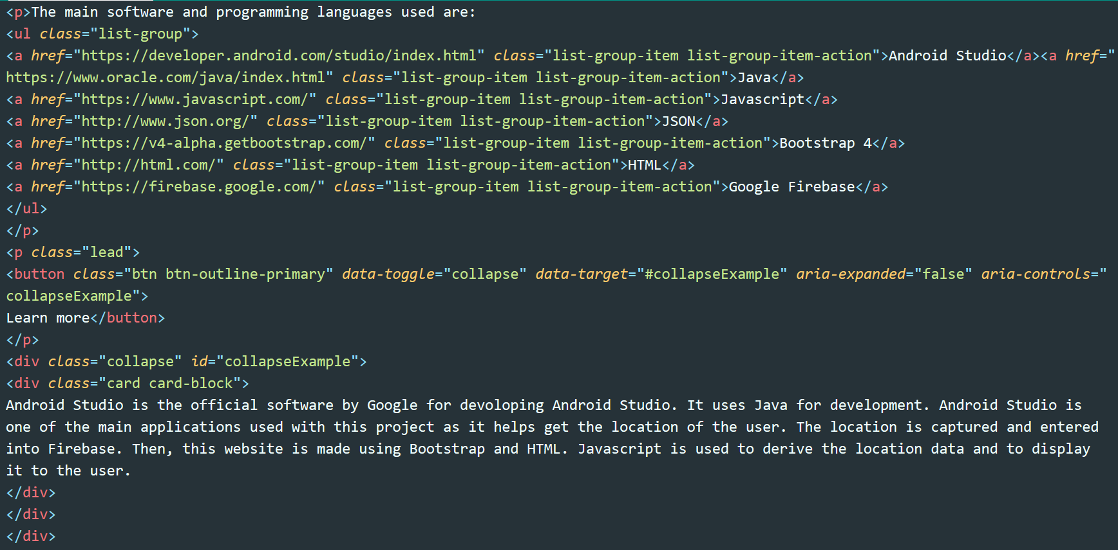
Webpage Code Part 1
Sample Bootstrap template usage for the home page.

Slide 25
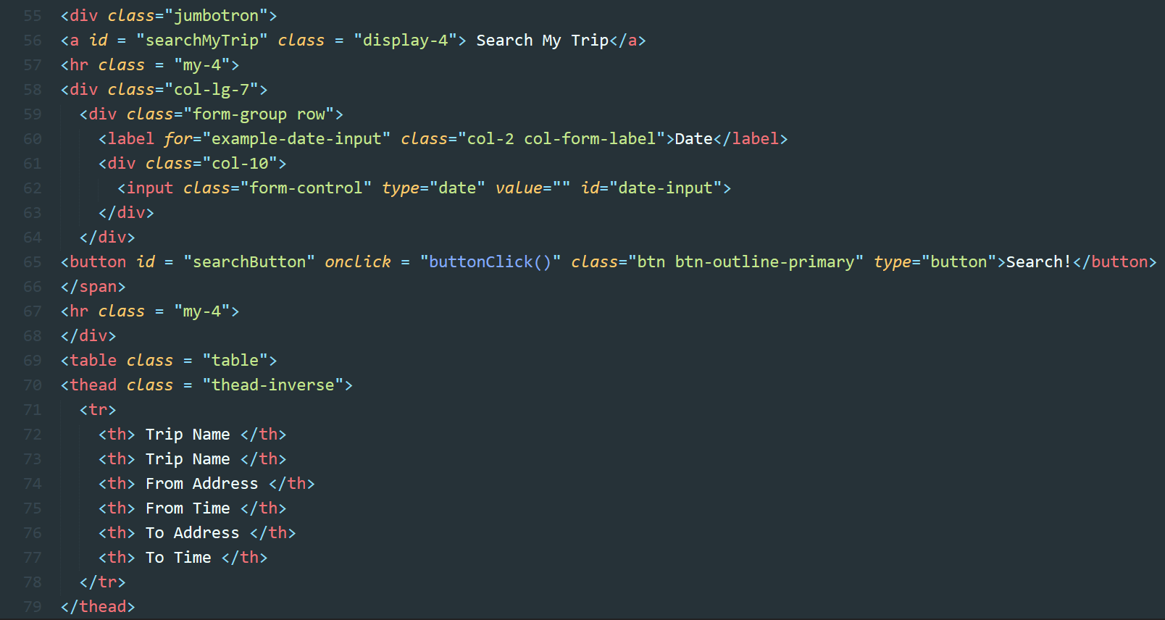
Webpage Code Part 2
The Search Function Setup with HTML and Bootstrap.

Slide 26
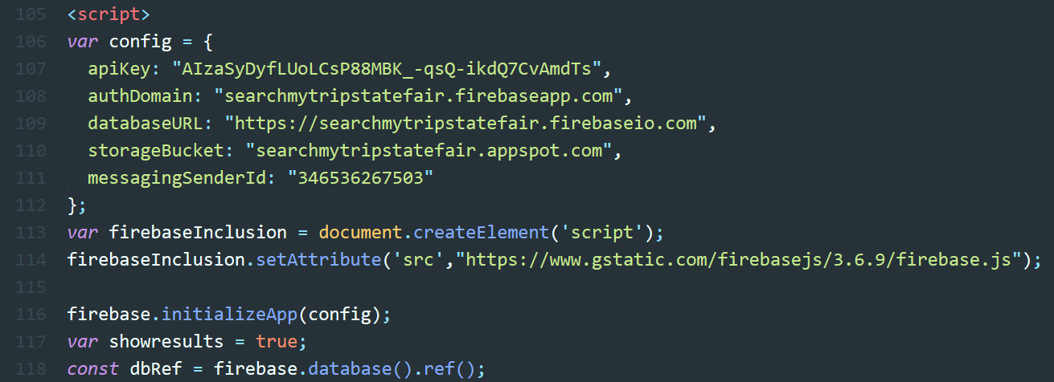
Webpage Code Part 3
Initial Firebase and Script setup for the upcoming functions.

Slide 27
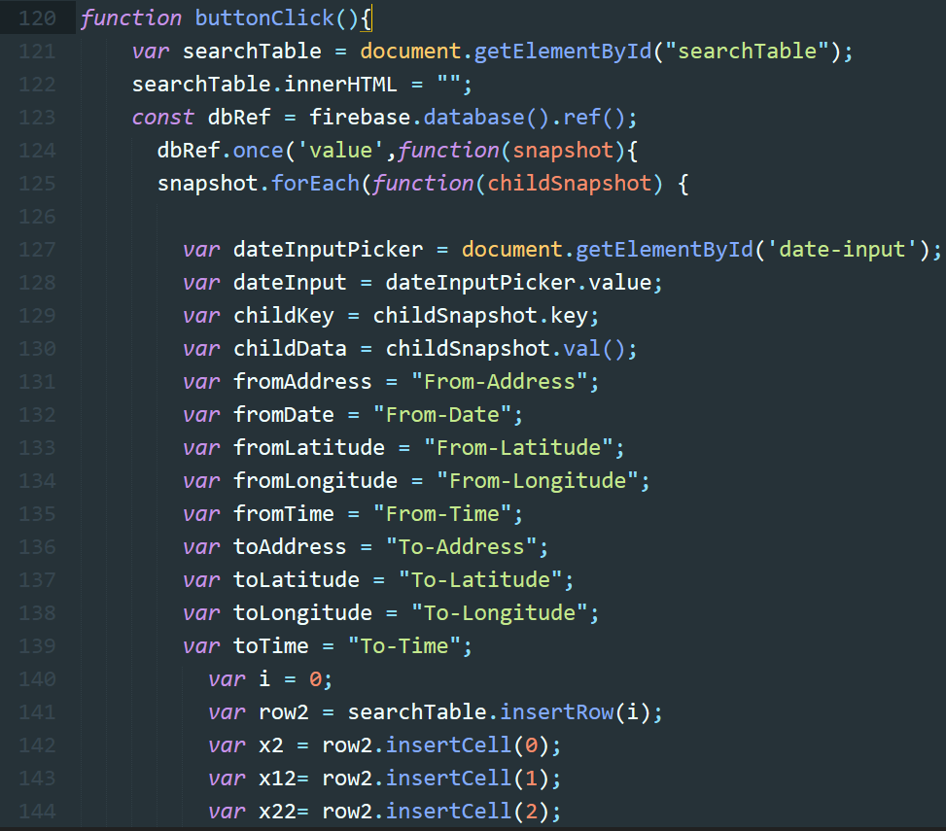
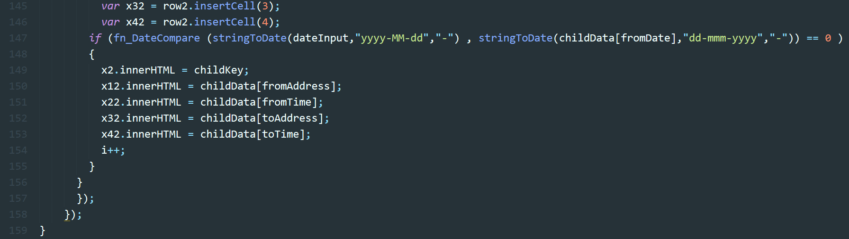
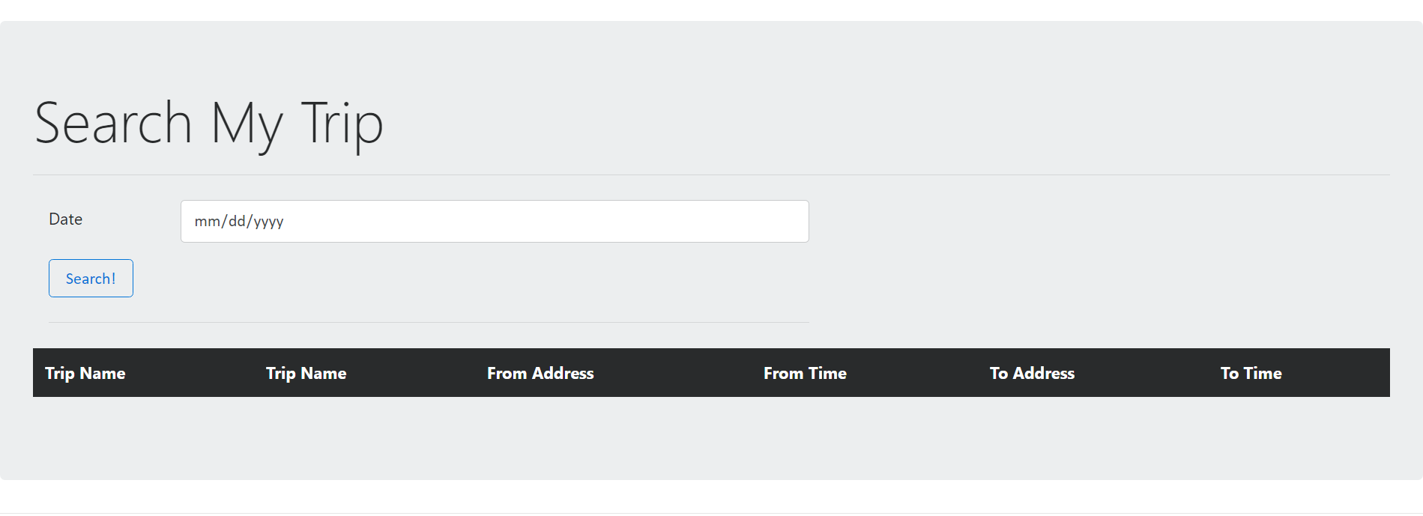
Webpage Code Part 4
Search Function when the user clicks on the button.

Slide 28
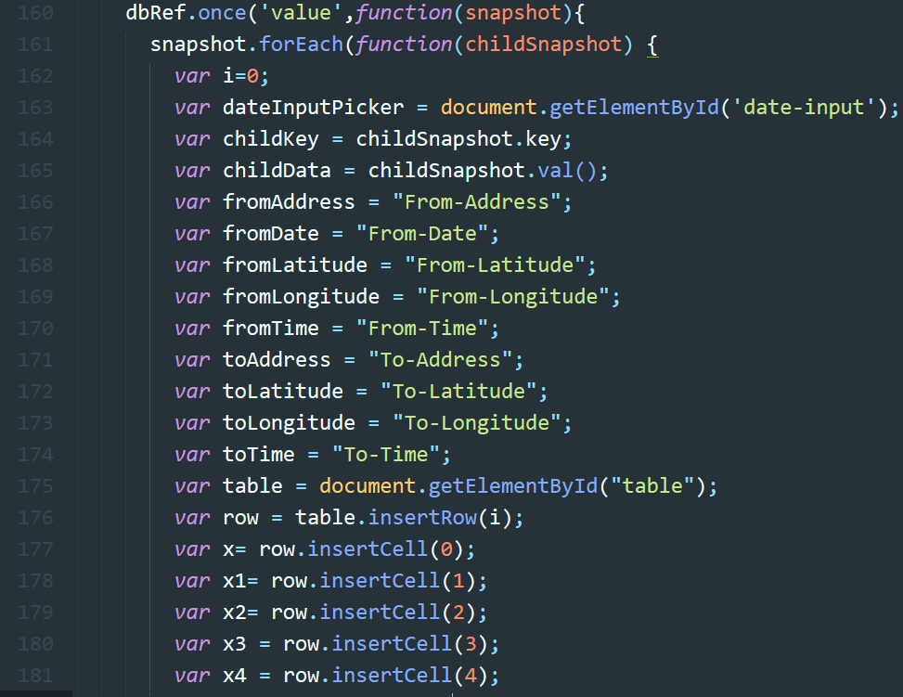
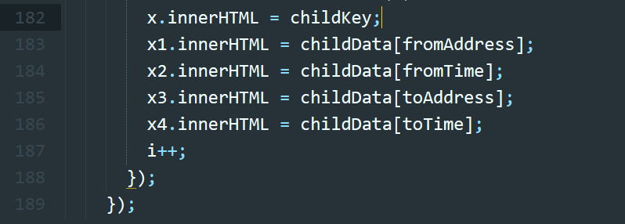
Webpage Code Part 5
Display data to the User in the form of a table.

Slide 29
Benefits
Knowing where you go.
Managing your drive time and reducing or increasing visits to a certain place after analyzing the data.

Slide 30
Upgrades and Updates
Android Auto is a car based smart Android device. This will be attached to the car so that when the user turns on their car, the app screen will popup enabling the user to enter their trip name to capture data.
Android Auto

Slide 31
Licensing
Firebase: Google Cloud Platform License, grants SSL certificate
Android App: Google Play Licensing
Android Studio: Apache Software License
The rest are open source.

Slide 32
Thank You!

